Slide 1


21 DAYS OF
MACHINE LEARNING
7/21
---Code Warriors---

Slide 2

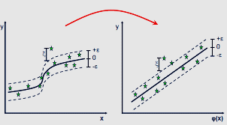
What is Support Vector Regression
We need an algorithm which supports both linear and non-linear regression. as it'll be easy to learn it and use it in any regression problems., and Support Vector Regression is a key to that.
---Code Warriors---

Slide 3
What is Support Vector Regression
In simple regression we try to minimise the error rate. While in SVR we try to fit the error within a certain threshold. This might be a bit confusing but let me explain.
-e <= y-mx-c <= e (e = error rate)
The problem of regression is to find a function that approximates mapping from an input domain to real numbers on the basis of a training sample. So let’s now dive deep and understand how SVR works actually.
Consider these two red lines as the decision boundary and the green line as the hyperplane. Our objective, when we are moving on with SVR, is to basically consider the points that are within the decision boundary line. Our best fit line is the hyperplane that has a maximum number of points.
---Code Warriors---

Slide 4
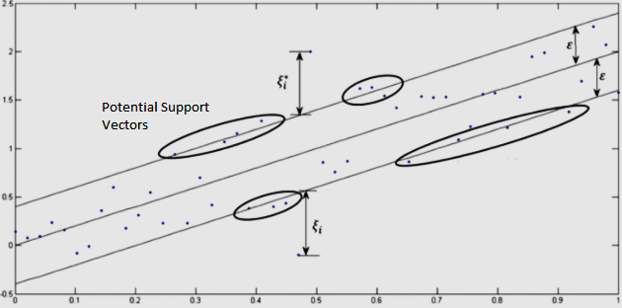
Terms and Hyperparameters
Kernel
error rate(e)
Hyper Plane
tolerance(ei)
Boundary Line
Support vectors
---Code Warriors---

Slide 5
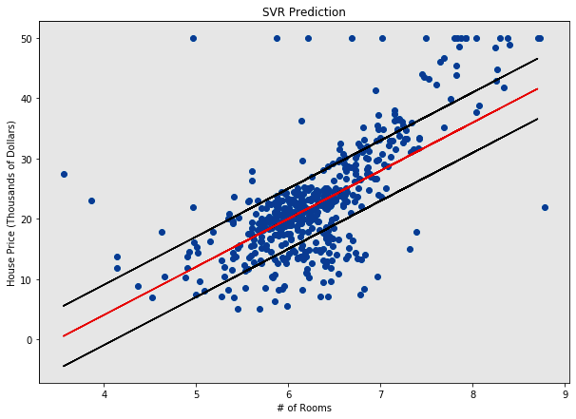
Multiple Linear Regression
Advantages
Dis-Advantages
Support both Linear and non linear regression
Memory Efficient
It is not suitable for large datasets.
Does not perform well when the dataset has much more noise.
---Code Warriors---

Slide 6
Support Vector Regression
1
from sklearn.svm import SVR
2
regressor = SVR(kernel = 'rbf')
3
regressor.fit(X_train, y_train)
4
y_pred = regressor.predict(X_test)
---Code Warriors---

